Slide 1
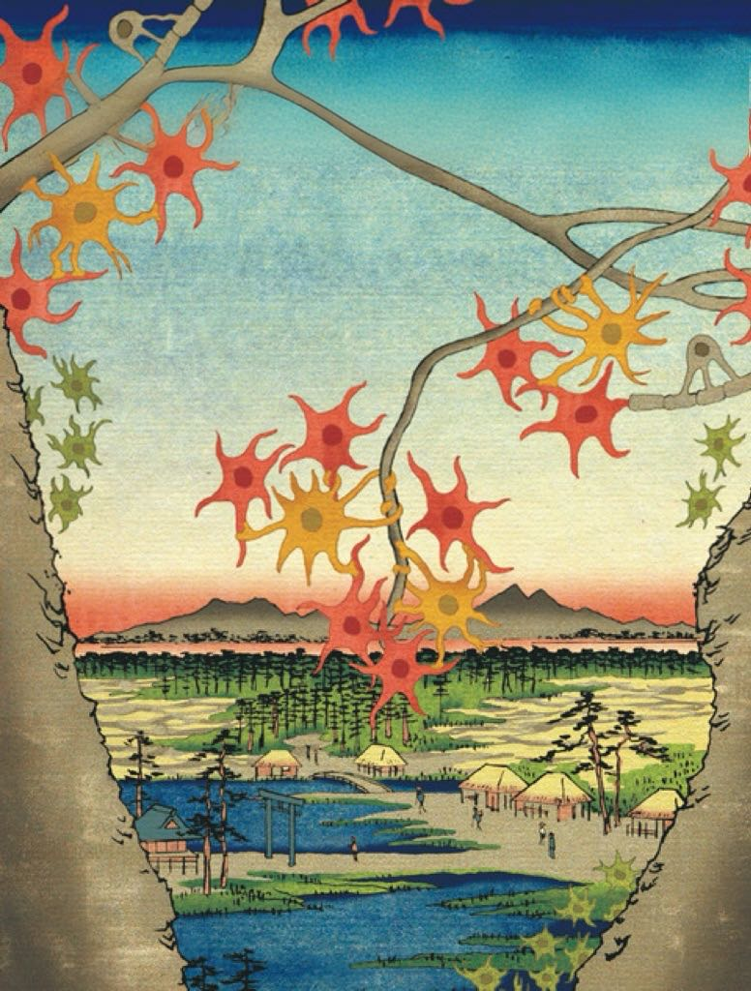
The Sheltering Metaphors
The Sheltering Metaphors
Last Iteration
Yi Xiao

Slide 2

Contents
Contents
Materials
Presentation
Initial goals
Future projects

Slide 3
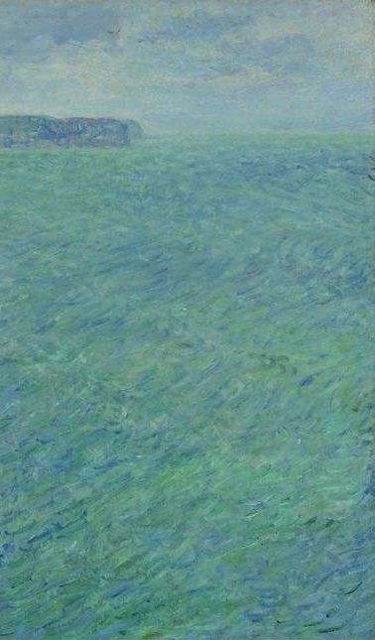
Timeline
Hodgkin and Huxley published five papers in a row that established the HH Model.
Adrian used Morse Code as the metaphor for neuron activity.
1939
1963
Hodgkin and Huxley first placed electrodes inside squid cells to record electrical signals.
Hodgkin and Huxley won Nobel Prize in Physiology or Medicine.
1926
1952

Slide 4
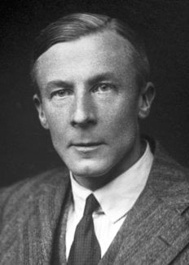
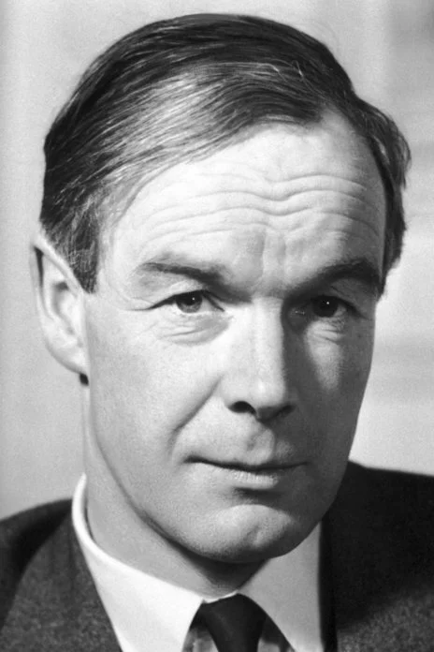
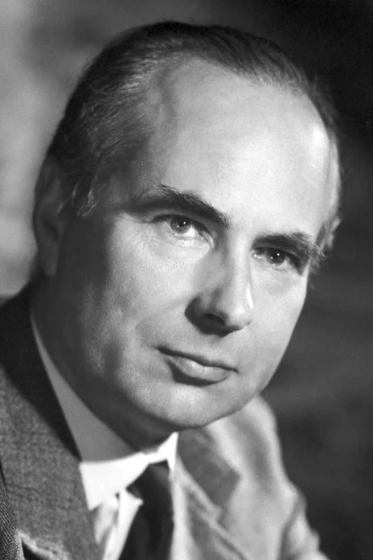
Metaphor Shifting
Research Questions
Photos from the Nobel Foundation archive.
Why did Hodgkin and Huxley adhere to the older theoretical model?
How has their research been reconciled with the rise of information theory and modern computational neuroscience?
Edgar Adrian
(1889-1977)
Alan Hodgkin
(1914-1998)
Andrew Huxley
(1917-2012)

Slide 5
Data
The historical sources used in this paper consist primarily of two parts：
1. publication: scientists’ essays, memoirs, autobiographies, eulogies; transcripts of lectures and interviews.
2. Archives:
（1）Alan Hodgkin Papers organized by Trinity College, Cambridge
（2）Warren McCulloch Papers in the American Philosophical Society Digital Collection.

Slide 6




Framework
Framework
From Electrical Systems to Electronic Circuits: Neurophysiology and Its Mechanical Metaphors
“Mostly Membranes”：Radar, Math and Modeling
Beyond “Spark” and “Soup” ： Forgotten Theories and Amnesia in Science

Slide 7
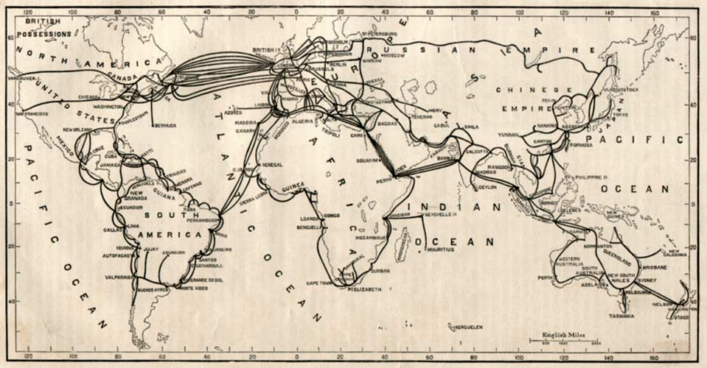
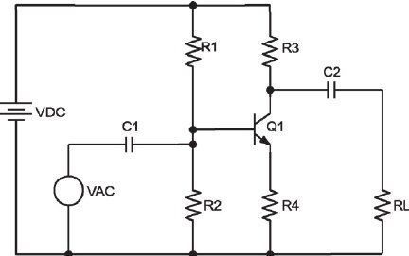
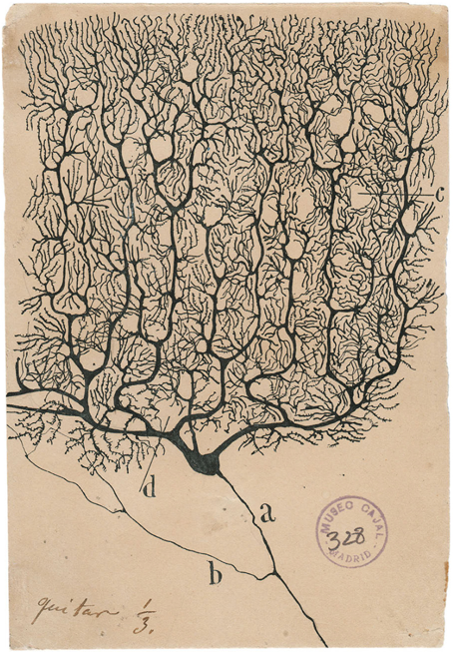

Conclusion
A metaphor is a tool we use to explore unknown territory and gain new knowledge by borrowing familiar concepts based on intuitive similarities in how things work or relate to each other.
It works as a shelter as well as an obscure.

Slide 8
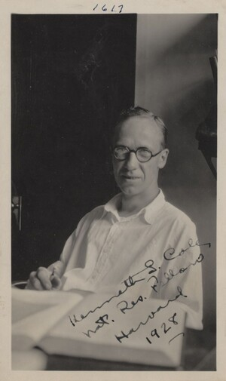
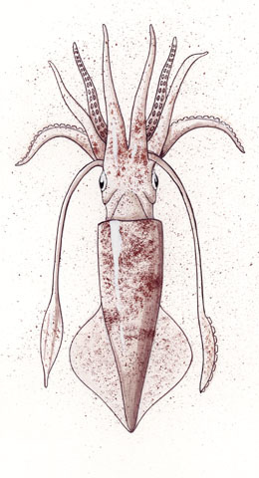
Initial Goals
Initial Goals
Explored from the perspective of a non-human participant, the squid, what role did squid play in the scientific discovery of action potentials?
And how did the trans-Atlantic scientific network work together?
Why did Hodgkin and Huxley adhere to the older theoretical model?
How has their research been reconciled with the rise of information theory and modern computational neuroscience?

Slide 9
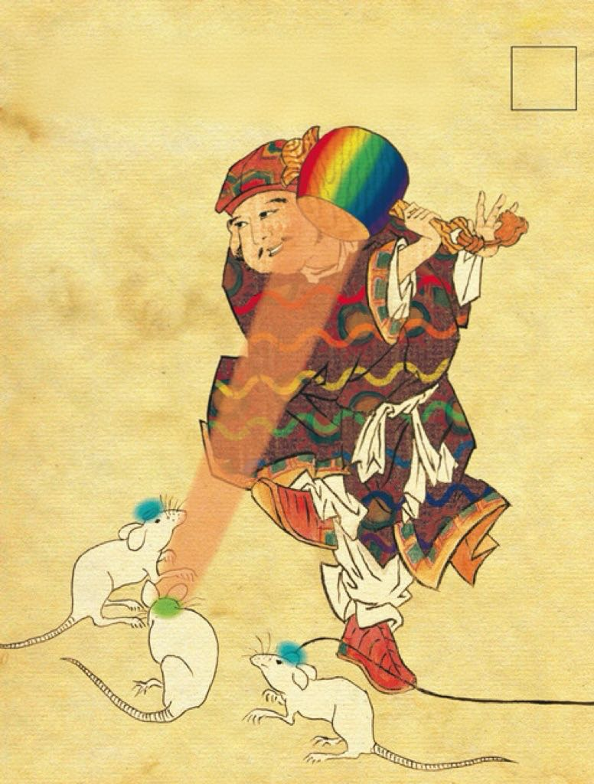
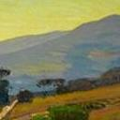


Future Projects
Future Projects
1
Learned the basics of Social Network Analysis, and while I didn‘t practice it enough this semester and soon found out I didn’t have to draw it myself, it was very useful and may be better used later in analyzing post-war Japanese-American academic networks, where node and edge data is more hidden than transatlantic one, for now.
2
Plotting line graphs using quantitative methods based on text analysis is a great way to confirm historical staging. Similar to Google's Books Ngram Viewer, it is great for identifying approximate historical staging before research.
3
At least found a good OCR tool for transcribing printed text（https://github.com/getomni-ai/zerox?tab=readme-ov-file#python-zerox）, although handwriting still doesn't work.

Slide 10

THANKS FOR LISTENING！
QUESTIONS？

